Slide 1


Chapter 15
Franchising
Bruce R. Barringer
R. Duane Ireland
Copyright ©2012 Pearson Education, Inc. publishing as Prentice Hall
15-<number>

Slide 2
Chapter Objectives
1 of 3
Explain franchising and how it differs from other forms of business ownership.
Describe the difference between a product and trademark franchise and a business format franchise.
Explain the differences among an individual franchise agreement, an area franchise agreement, and a master franchise agreement.
Describe the advantages of establishing a franchise system as a means of firm growth.
Copyright ©2012 Pearson Education, Inc. publishing as Prentice Hall
15-<number>

Slide 3
Chapter Objectives
2 of 3
5. Identify the rules of thumb for determining when franchising is an appropriate form of growth for a particular business.
6. Discuss the factors to consider in determining if owning a franchise is a good fit for a particular person.
7. Identify the costs associated with buying a franchise.
8. Discuss the advantages and disadvantages of buying a franchise.
Copyright ©2012 Pearson Education, Inc. publishing as Prentice Hall
15-<number>

Slide 4
Chapter Objectives
3 of 3
9. Identify the common mistakes franchise buyers make.
10. Describe the purpose of the Franchise Disclosure Document.
Copyright ©2012 Pearson Education, Inc. publishing as Prentice Hall
15-<number>

Slide 5
Introduction to Franchising
Introduction
  Franchising is growing in popularity.
  In 2007 (the most recent year statistics are available), nearly 766,000 franchise outlets were operating in the U.S.
History
  The word “franchise” comes from an old dialect of French and means privilege or freedom.
  Many of the most popular franchises, including KFC (1952), McDonald’s (1955), and H&R Block (1958) started as early as the 1950s.
Copyright ©2012 Pearson Education, Inc. publishing as Prentice Hall
15-<number>

Slide 6
What is Franchising?
Franchising
  Franchising is a form of business organization in which a firm that already has a successful product or service (franchisor) licenses its trademark and method of doing business to another business or individual (franchisee) in exchange for a franchise fee and an ongoing royalty payment.
  Some franchisors are established firms (like McDonald’s) while others are first-time enterprises being launched by entrepreneurs.
Copyright ©2012 Pearson Education, Inc. publishing as Prentice Hall
15-<number>

Slide 7
Two Types of Franchise Systems
1 of 2
Product and Trademark Franchise
  An arrangement under which the franchisor grants to the franchisee the right to buy its products and use its trade name.
  This approach typically connects a single manufacturer with a network of dealers or distributors.
    For example, General Motors has established a network of dealers that sell GM cars and use the GM trademark in their advertising and promotions.
    Other examples of product and trademark franchisors include agricultural machinery dealers, soft drink bottlers, and beer distributorships.
Copyright ©2012 Pearson Education, Inc. publishing as Prentice Hall
15-<number>

Slide 8
Two Types of Franchise Systems
2 of 2
Business Format Franchise
  An arrangement under which the franchisor provides a formula for doing business to the franchisee along with training, advertising, and other forms of assistance.
  Fast-food restaurants, convenience stores, and motels are well-known examples of business format franchises.
    Business format franchises are by far the most popular form of franchising, particularly for entrepreneurial firms.
Copyright ©2012 Pearson Education, Inc. publishing as Prentice Hall
15-<number>

Slide 9
Top 10 Business Lines in Which Business Format Franchises Operate
Automotive
Commercial and residential services
Quick service restaurants
Table/Full-service restaurants
Retail food
Lodging
Real Estate
Retail products and services
Business services
Personal services
Copyright ©2012 Pearson Education, Inc. publishing as Prentice Hall
15-<number>

Slide 10
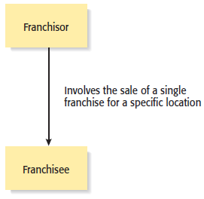
Types of Franchise Agreements
1 of 3
Individual Franchise Agreement
Copyright ©2012 Pearson Education, Inc. publishing as Prentice Hall
15-<number>

Slide 11
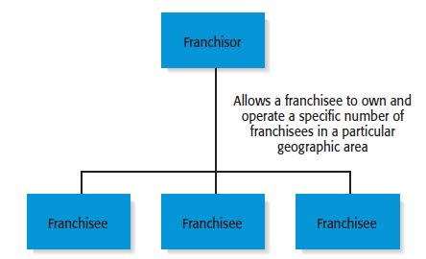
Types of Franchise Agreements
2 of 3
Area Franchise Agreement
Copyright ©2012 Pearson Education, Inc. publishing as Prentice Hall
15-<number>

Slide 12
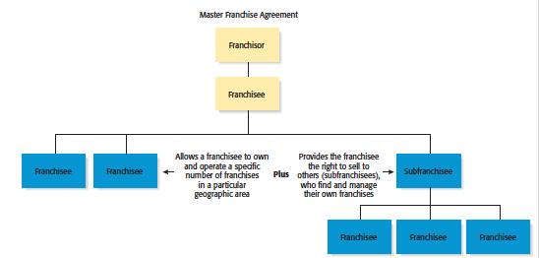
Types of Franchise Agreements
3 of 3
Master Franchise Agreement
Copyright ©2012 Pearson Education, Inc. publishing as Prentice Hall
15-<number>

Slide 13
When to Franchise?
From the Franchisor’s Point of View
1 of 2
Approach Franchising With Caution and Care
  Establishing a franchise system should be approached carefully and deliberately.
  Franchising is a complicated business endeavor, and an entrepreneur must look closely at all its aspects before deciding to franchise.
Regulations
  An entrepreneur should also be aware that over the years a number of fraudulent franchise organizations have come and gone and have left financially ruined franchise owners behind.
Copyright ©2012 Pearson Education, Inc. publishing as Prentice Hall
15-<number>

Slide 14
When to Franchise?
2 of 2
When Is Franchising Most Appropriate?
  Franchising is most appropriate when a firm has a strong or potentially strong trademark, a well-designed business method, and a desire to grow.
  A franchise system will ultimately fail if the franchisee’s brand doesn’t add value for customers and its business method is flawed or poorly developed.
Copyright ©2012 Pearson Education, Inc. publishing as Prentice Hall
15-<number>

Slide 15
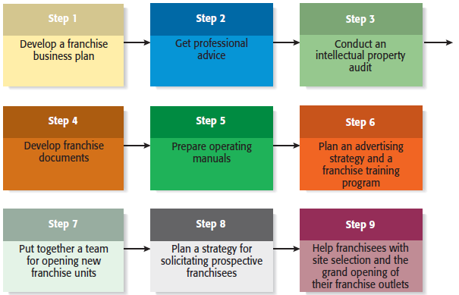
Nine Steps in Setting Up a Franchise System
Copyright ©2012 Pearson Education, Inc. publishing as Prentice Hall
15-<number>

Slide 16
Qualities to Look for in Prospective Franchisees
Good work ethic
Ability to follow instructions
Ability to operate with minimal supervision
Team oriented
Experience in the industry in which the franchise competes
Adequate financial resources and good credit history
Ability to make suggestions without becoming confrontational
or upset if the suggestions are not adopted
Represents the franchisor in a positive manner
Copyright ©2012 Pearson Education, Inc. publishing as Prentice Hall
15-<number>

Slide 17
Ways Franchisors Can Develop the Potential of Their Franchisees
Provide mentoring that supersedes routine training.
Keep operating manuals up-to-date.
Keep products, services, and business systems up to date.
Solicit input from franchisees to reinforce their importance in
the larger system.
Encourage franchisees to develop a franchise association.
Maintain the franchise system’s integrity.
Copyright ©2012 Pearson Education, Inc. publishing as Prentice Hall
15-<number>

Slide 18
Advantages and Disadvantages of Franchising as a Method of Business Expansion
Advantages
Disadvantages
Rapid, low-cost market expansion
Income from franchise fees and
royalties
Franchisee motivation
Access to ideas and suggestions
Cost savings
Increased buying power
Profit sharing
Loss of control
Friction with franchisees
Managing growth
Differences in required business skills
Legal expenses
Copyright ©2012 Pearson Education, Inc. publishing as Prentice Hall
15-<number>

Slide 19
Buying a Franchise
From the Franchisee’s Point of View
1 of 3
Buying a Franchise
  Purchasing a franchise is an important business decision involving a substantial financial commitment.
  Potential franchise owners should strive to be as well informed as possible before purchasing a franchise and should be aware that it is often legally and financially difficult to exit a franchise relationship.
Copyright ©2012 Pearson Education, Inc. publishing as Prentice Hall
15-<number>

Slide 20
Buying a Franchise
2 of 3
Answering the following questions will help determine if franchising is right for you
Are you willing to take orders? Franchises are typically
very particular about how outlets operate.
Are you willing to be part of a franchise “system” rather
than be an independent businessperson?
How will you react if you make a suggestion to your
franchisor and your suggestion is rejected?
What are you looking for in a business? How hard do you
want to work?
Copyright ©2012 Pearson Education, Inc. publishing as Prentice Hall
15-<number>

Slide 21
Buying a Franchise
3 of 3
Answering the following questions will help determine if franchising is right for you
How willing are you to put your money at risk? How will
you feel if your business is operating at a net loss but you
will have to pay royalties on your gross income?
Copyright ©2012 Pearson Education, Inc. publishing as Prentice Hall
15-<number>

Slide 22
The Costs Involved With Buying a Franchise
1 of 3
Initial Franchise Fee
  The initial fee varies depending on the franchisor.
Capital Requirements
  The costs vary but may include the cost of buying real estate, the cost of putting up a building, the purchase of inventory, and the cost of obtaining a business license.
Continuing Royalty Payment
  Is usually around 5% of monthly gross income.
Copyright ©2012 Pearson Education, Inc. publishing as Prentice Hall
15-<number>

Slide 23
The Costs Involved With Buying a Franchise
2 of 3
Advertising Fees
  Franchisees are often required to pay into a national or regional advertising fund.
Other Fees
  Other fees may be charged for various activities, including:
    Training additional staff
    Providing management expertise when needed
    Providing computer assistance
    Providing a host of other items or support services
Copyright ©2012 Pearson Education, Inc. publishing as Prentice Hall
15-<number>

Slide 24
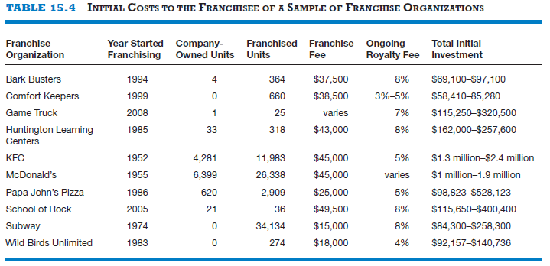
The Costs Involved With Buying a Franchise
3 of 3
Copyright ©2012 Pearson Education, Inc. publishing as Prentice Hall
15-<number>

Slide 25
Advantages and Disadvantages of Buying a Franchise
Advantages
Disadvantages
A proven product or service within
an established market
An established trademark or
business system
Franchisor’s training, technical
expertise, and managerial expertise
An established marketing network
Franchisor ongoing support
Availability of financing
Potential for business growth
Cost of the franchise
Restrictions on creativity
Duration and nature of the commitment
Risk of fraud, misunderstandings, or
lack of franchisor commitment
Problems of termination or transfer
Poor performance on the part of other
franchisees
Potential for failure
Copyright ©2012 Pearson Education, Inc. publishing as Prentice Hall
15-<number>

Slide 26
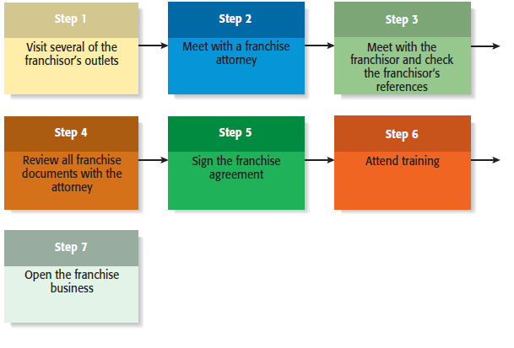
Seven Steps in Purchasing a Franchise
Copyright ©2012 Pearson Education, Inc. publishing as Prentice Hall
15-<number>

Slide 27
Watch Out! Common Misconceptions About Franchising
Franchising is a safe investment.
A strong industry ensures franchise success.
A franchise is a “proven” business system.
There is no need to hire a franchise attorney or an accountant.
The best systems grow rapidly and it is best to be part of a rapid-growth
system.
I can operate my franchise outlet for less than the franchisor predicts.
The franchisor is a nice person—he’ll help me out if I need it.
Copyright ©2012 Pearson Education, Inc. publishing as Prentice Hall
15-<number>

Slide 28
Legal Aspects of the Franchise Relationship
Federal Rules and Regulations
  The offer and sale of a franchise are regulated at the federal level.
    According to Federal Trade Commission (FTC) rule 436, franchisors must furnish potential franchisees with written disclosures that provide information about the franchisor, the franchised business, and the franchise relationship.
    In most cases, the disclosures are made through a lengthy document referred to as the Franchisor Disclosure Document (FDD).
    The FDD contains 23 categories of information that give a prospective franchisee a broad base of information about the background and financial health of the franchisor.
Copyright ©2012 Pearson Education, Inc. publishing as Prentice Hall
15-<number>

Slide 29
More About Franchising
1 of 2
Franchise Ethics
  The majority of franchisors and franchisees are highly ethical.
  There are certain features of franchising, however, that make it subject to ethical abuse. These features are as follows:
    The get-rich-quick mentality
    The false assumption that buying a franchise is a guarantee of business success
    Conflicts of interest between franchisors and franchisees
Copyright ©2012 Pearson Education, Inc. publishing as Prentice Hall
15-<number>

Slide 30
More About Franchising
2 of 2
International Franchising
  International opportunities for franchising are becoming more prevalent for the following two reasons:
    The markets for certain franchised products in the U.S. have become saturated (i.e., fast food).
    The trend toward globalization continues.
  Steps to take before buying a franchise overseas:
    Consider the value of the franchisor’s name in the foreign country.
    Get a good lawyer.
    Determine whether the product or service is saleable in the foreign country.
    Find out how much training and support you will receive from the franchisor.
Copyright ©2012 Pearson Education, Inc. publishing as Prentice Hall
15-<number>

Slide 31

All rights reserved. No part of this publication may be reproduced, stored in a retrieval system, or transmitted, in any form or by any means, electronic, mechanical, photocopying, recording, or otherwise, without the prior written permission of the publisher. Printed in the United States of America.
Copyright ©2012 Pearson Education, Inc. publishing as Prentice Hall
Copyright ©2012 Pearson Education, Inc. publishing as Prentice Hall
15-<number>

